Slide 1
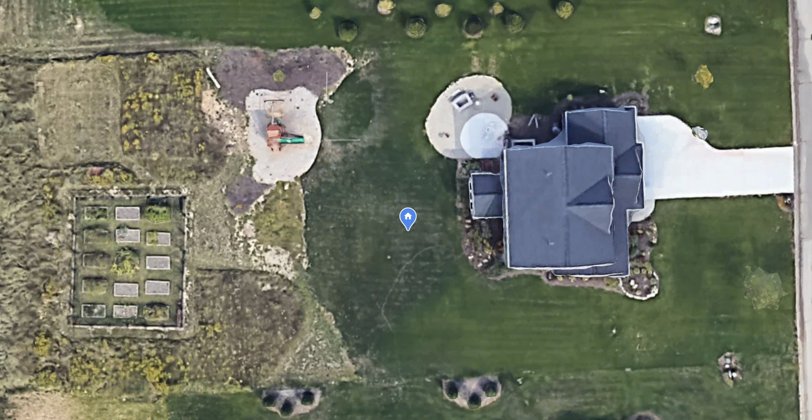

Slide 3
Existing Back Yard Sprinklers
1” Water Supply Line and
Valve Control Cable already here.

Slide 4
Proposed additional sprinklers
Add two new zones (orange and purple)
Add three sprinklers to existing zone.

